Slide 1

work breakdown structures Lecture 5
http://www.pm-primer.com/wp-content/uploads/2012/04/wbs1.jpg
G.R. Labbé

Slide 2
Work Breakdown Structure
Definition: A Work Breakdown Structure (WBS) is a deliverable
oriented grouping of project components that organizes
and defines the total scope of the project.
The WBS is the project scope broken down first into smaller manageable pieces that define major outcomes or deliverables of the project.
Each major outcome is then further divided into smaller more manageable “chunks” or work packages.
These work packages identify the tasks that need to be completed to produce the deliverable.
Project Managers cannot, in fact nobody can, manage projects. Project Managers manage pieces of projects.

Slide 3
Work Breakdown Structure
The goals of a well developed WBS are:
Allows the project team to logically plan all the steps required to successfully complete the project.
Collect and organize all information required to complete the defined tasks.
Organize tasks into smaller more manageable components that can be assigned to the team members for completion.
A well defined WBS allows for the creation of a WBS dictionary. The dictionary defines the requirements for each task and allows for more detail to be presented.

Slide 4
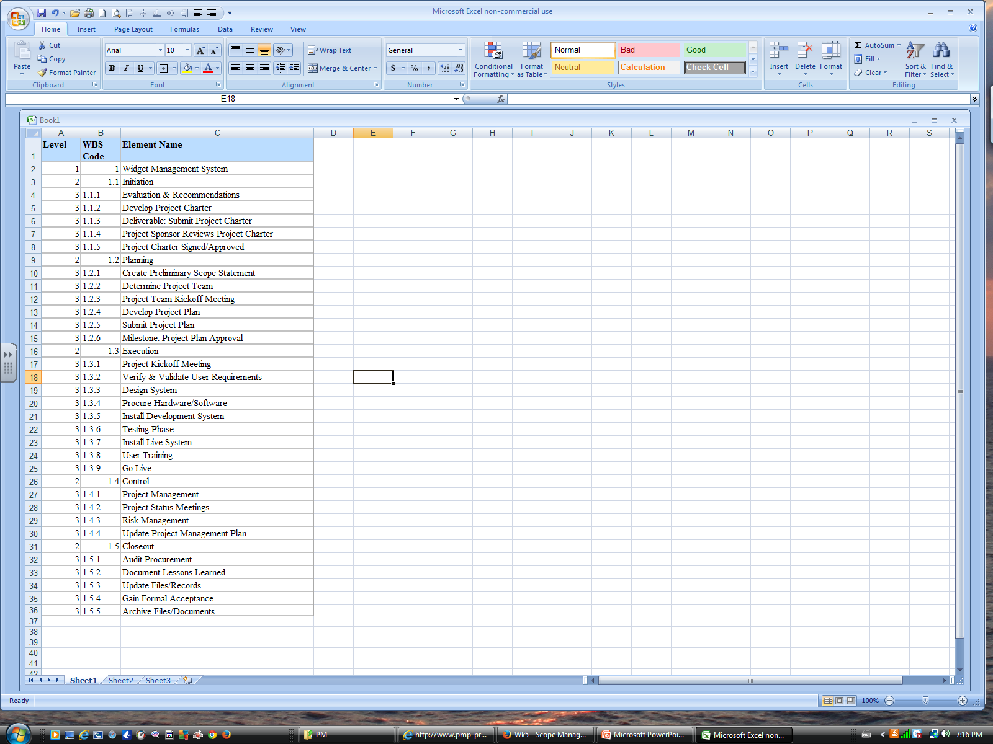
Hierarchical Structure
Note the use of a numbering sequence to identify levels.
Level 1 is defined as the Project level
(What is the project?)
Level 2 is the Summary level. (This is the project broken into its major components.)
Level 3 is the start of the Work Package level. (Depending upon the complexity of the work package there can be further levels created.)
http://img.bhs4.com/d8/9/d8937ed5232ddab17d38faec3b4bcc92c2767867_large.jpg

Slide 5
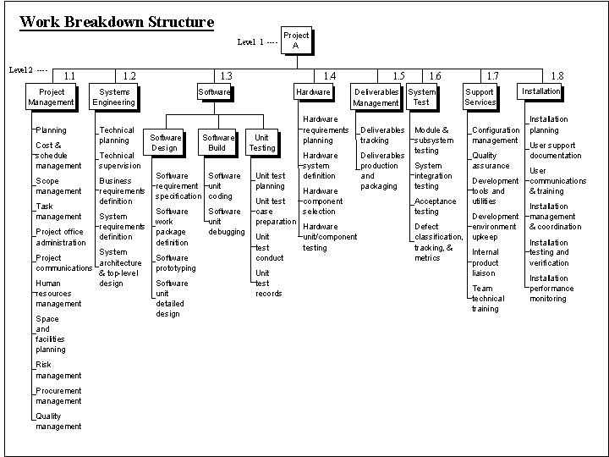
structure View
http://www.hyperthot.com/pm_wbs_swhw.gif

Slide 6
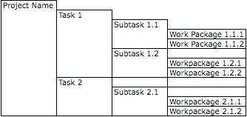
Tabular View
Each level clearly breaks the tasks down into smaller
more manageable tasks.

Slide 7
Creating a wbs
The WBS is organized around the primary products of the project (or planned outcomes) instead of the work needed to produce the products (planned actions).
For example:
✅ Outcome-based: “Training Module Completed”
❌ Action-based: “Write training script,” “Record video,” “Upload to platform
Since the planned outcomes are the desired ends of the project, they form a relatively stable set of categories in which the costs of the planned actions needed to achieve them can be collected.
A well-designed WBS makes it easy to assign each project activity to one and only one terminal element of the WBS.
There are several design principles that must be followed when creating a WBS. We are going to look at these in detail in the next few slides:

Slide 8
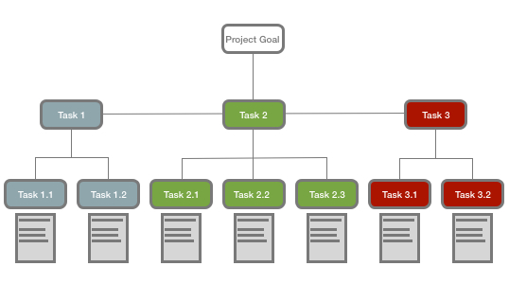
Design principles – 100% Rule
The 100% rule states that the WBS includes 100% of the work defined by the project scope and captures all deliverables – internal, external, interim – in terms of the work to be completed.
The rule applies at all levels within the hierarchy: the sum of the work at the "child" level must equal 100% of the work represented by the "parent" and the WBS should not include any work that falls outside the actual scope of the project, that is, it cannot include more than 100% of the work.
http://www.exceltemp.com/wp-content/uploads/2014/07/WBS.jpg

Slide 9
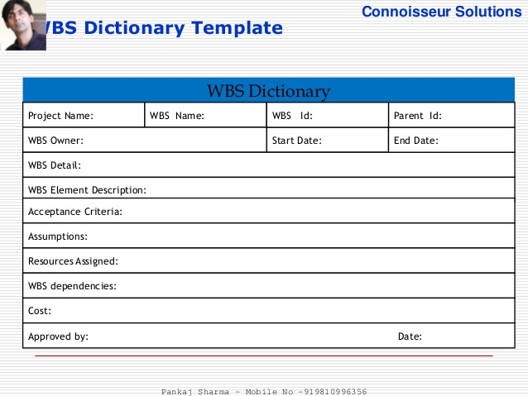
Design principles – mutually exclusive
It is important that there is no overlap in scope definition between different elements of a work breakdown structure. This ambiguity could result in duplicated work or miscommunications about responsibility and authority.
Such overlap could also cause confusion regarding project cost accounting. If the WBS element names are ambiguous, a WBS dictionary can help clarify the distinctions between WBS elements.
mage.slidesharecdn.com/projectscopemanagement5ver-150330184729-conversion-gate01/95/project-scope-management-pmbok-5th-edition-24-638.jpg?cb=1427741284

Slide 10
Design principles – plan outcomes, not actions
If the work breakdown structure designer attempts to capture any action-oriented details in the WBS, he/she will likely include either too many actions or too few actions.
Too many actions will exceed 100% of the parent's scope and too few will fall short of 100% of the parent's scope. The best way to adhere to the 100% rule is to define WBS elements in terms of outcomes or results, not actions.
This also ensures that the WBS is not overly prescriptive of methods, allowing for greater ingenuity and creative thinking on the part of the project participants.

Slide 11
Design principles – level of detail
A work package at the activity level is a task that:
can be realistically and confidently estimated;
makes no sense practically to break down any further;
produces a deliverable which is measurable; and
forms a unique package of work which can be outsourced or contracted out.
One must decide when to stop dividing work into smaller elements. This will assist in determining the duration of activities necessary to produce a deliverable defined by the WBS.

Slide 12
Design principles – level of detail
There are several "rules of thumb" used when determining the appropriate duration of an activity or group of activities necessary to produce a specific deliverable defined by the WBS.
The first is the "80-hour rule" which means that no single activity or group of activities at the lowest level of detail of the WBS to produce a single deliverable should be more than 80 hours of effort.
The second rule of thumb is that no activity or group of activities at the lowest level of detail of the WBS should be longer than a single reporting period. Thus, if the project team is reporting progress monthly, then no single activity or series of activities should be longer than one month long.
In general, no task is defined at less than 8 hours to complete.
The last one is the "if it makes sense" rule. Applying this rule of thumb, one can apply "common sense" when creating the duration of a single activity or group of activities necessary to produce a deliverable defined by the WBS.

Slide 13
Why is the WBS so Important ?
Estimating
Staffing
WBS
Risk
Network
Diagram

Slide 14
WBS Dictionary - explained
Used to control what work is done and when;
Used to prevent scope creep;
Used to understand the effort for each task;
Physically the WBS dictionary is written when the WBS work packages are posted on a wall or white board in a logical sequence relative to one another to reflect the flow of work. When they are removed in numerical order, the WBS Dictionary is generated;
Entries in the dictionary are referred to as task descriptions; and,
Frequently they are arranged on color coded work packages to clearly identify the hierarchy of the task.

Slide 15
WBS Dictionary
WBS Dictionary (Task Description)
Project name:_________ | Task #:_______________ | Date Issued:___________ | Person Assigned:_______
Task Description: (what work is authorized)
Quantified Objectives: (See the description in the project charter)
Product Description: (what is the result of the work package?)
Acceptance Criteria: (how will the team member be able to check their work?)
Deliverables: (See the description in the project charter)
Assumptions:
Resources Assigned:
Duration:
Cost:
Due Date:
Interdependencies: Before this task______________ After this task______________
Approved by: Project Manager________________________ Date_______________

Slide 16
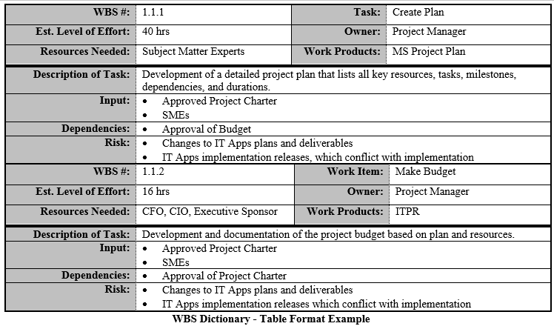
WBS Dictionary
doit.maryland.gov/sdlc/formservertemplates/wbs.doc

Slide 17
WBS Dictionary exercise
In your group, take one task from your WBS that you created earlier and create a WBS dictionary for it.

Slide 18
Work Authorization
Once the scope has been decomposed into useful work packages, the next natural step is to get formal agreement between stakeholders regarding project content known as the work authorization. If the client is external, this likely includes the contract Sign-Off.
Project management contracts to be valid require and consist of at least:
Possessing the legal right to contract;
Being of legal age to contract (18yo in Ontario and Québec and 19 or 21yo in other jurisdictions in Canada);
Being of sound mind at the time of signing;
Valid and Legal Consideration for both parties;
A legal scope of work; and,
Offer and acceptance.

Slide 19
Work Authorization
Project management contracts also likely contain many of the following (but not limited to):
Excusable delays;
Allowable costs;
Statements of liquidated damages (non-performance clauses);
Criteria for Inspection;
Responsibility for correction of defects; and,
Dispute resolution mechanisms.

